Slide 1
NUTRITION agent
Student name : Sneha Kabra
College Name & Department : MIT Academy of Engineering & Electronics and Telecommunicaton

Slide 2
OUTLINE
Problem Statement
Technology used
Wow factor
End users
Result
Conclusion
Git-hub Link
Future scope
IBM Certifications

Slide 3
Problem Statement
In today’s health-conscious world, people are increasingly looking for personalized nutrition guidance. However, current diet apps offer generic recommendations, ignoring critical factors like:
Individual health goals (e.g., weight loss, diabetes)
Allergies, cultural preferences, and lifestyle
Real-time adaptability to changing routines and feedback
SOLUTION
We propose “The Smartest AI Nutrition Assistant”—a virtual agent powered by Generative AI, capable of:
Understanding inputs via text or image (e.g., food photos, grocery labels)
Creating dynamic meal plans based on health data, fitness routines, medical conditions, and personal preferences
Offering smart food swaps, nutritional explanations, and real-time adaptability
Continuously learning through user feedback

Slide 4
Technology used
IBM cloud lite services
Retrieval Augmented Generation (RAG)
IBM Granite model

Slide 5
IBM cloud services used
IBM Cloud Watsonx AI Studio
IBM Cloud Watsonx AI runtime
IBM Cloud Agent Lab
IBM Granite foundation model

Slide 6
Wow factors
The Smartest AI Nutrition Assistant offers a revolutionary leap in personalized nutrition through the following standout features:
Multimodal Understanding Accepts inputs via text, voice, and images—such as food photos or grocery labels—for instant analysis and recommendations.
Dynamic & Personalized Meal Planning Creates meal plans tailored to individual health goals, medical conditions, fitness levels, preferences, and evolving feedback.
Real-Time Smart Food Swaps Instantly suggests healthier, culturally appropriate alternatives while maintaining nutritional balance and taste preferences.
Explainable AI Recommendations Provides clear explanations for each suggestion, helping users understand why a certain food or choice is better for them.
Culturally Sensitive & Inclusive Takes into account traditional cuisines, religious dietary restrictions, and regional food practices.
Continuous Learning & Adaptability Learns and improves over time based on user behavior, feedback, and health data, delivering a truly evolving virtual nutrition coach.

Slide 7
End users
Health-Conscious Individuals
Patients with Medical Conditions
Fitness Enthusiasts and Athletes
Busy Professionals and Students
Vegetarians, Vegans, and Cultural Diet Followers
Nutritionists and Dieticians

Slide 8
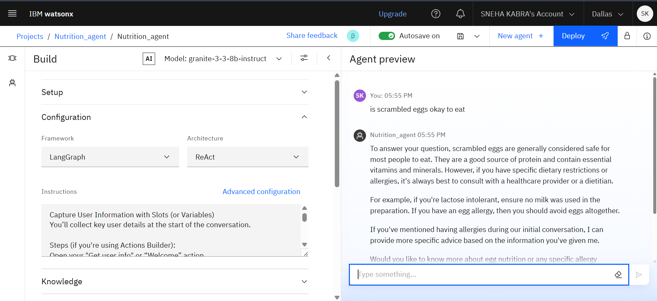
Results

Slide 9
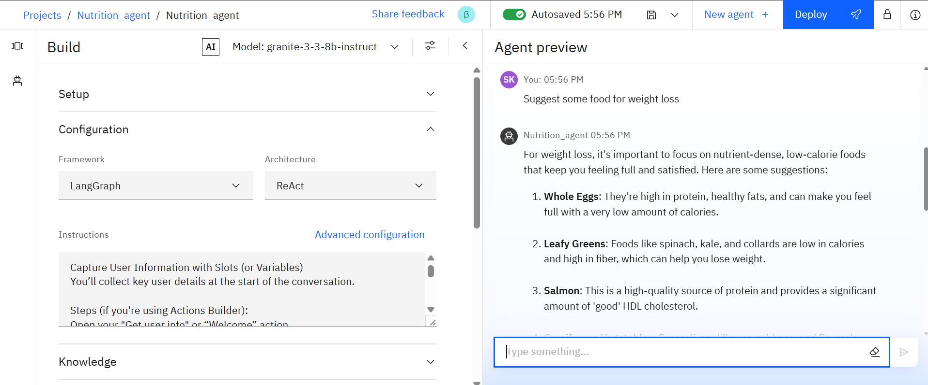
Results

Slide 10
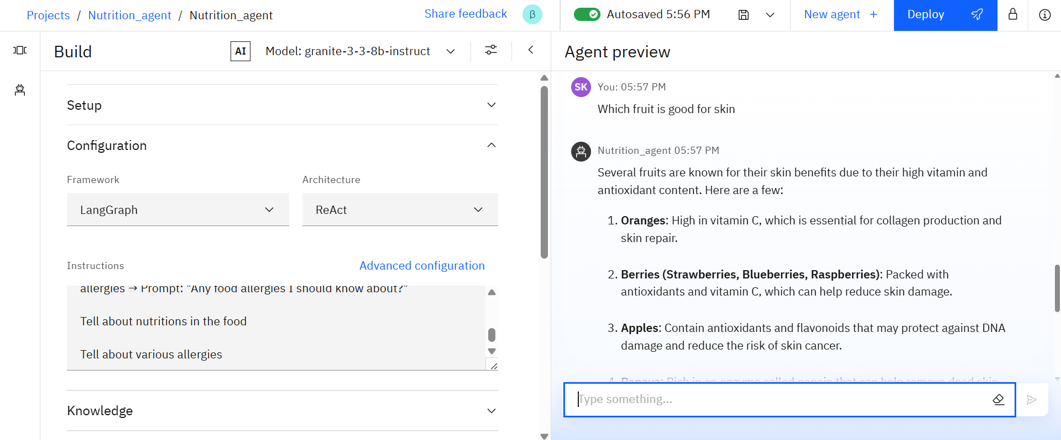
Results

Slide 11
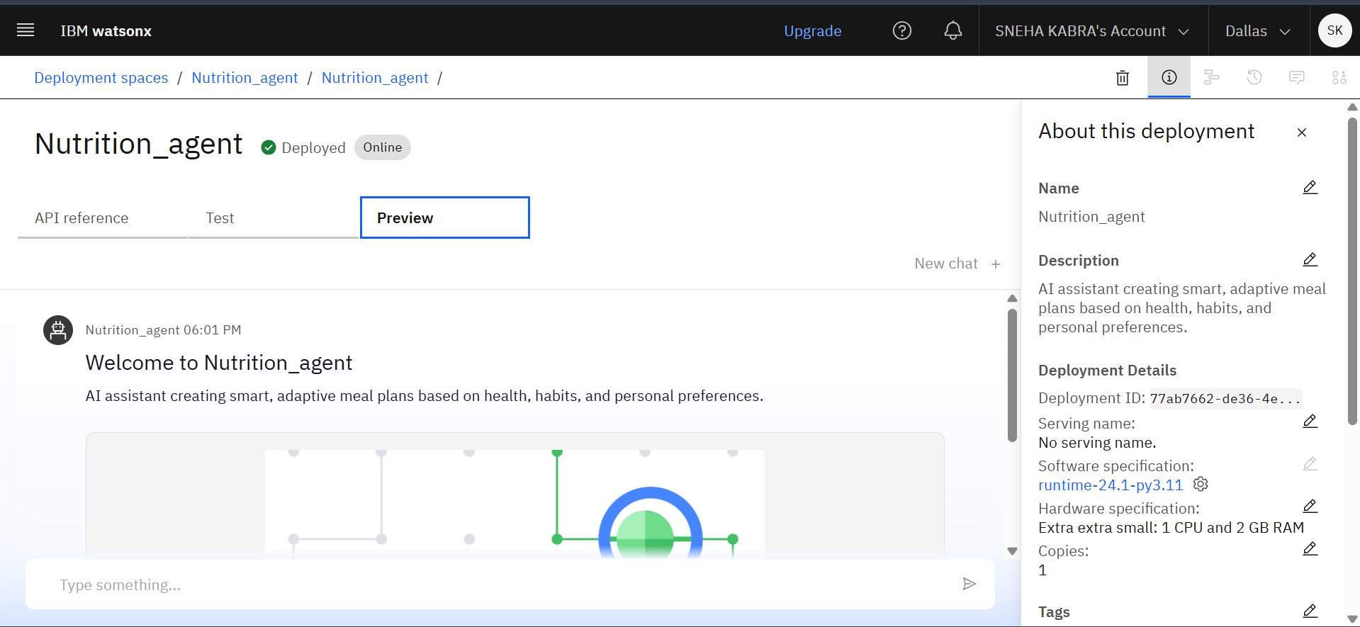
Results
Deployed AI Agent

Slide 12
Conclusion
The AI Nutrition Assistant offers personalized, real-time meal planning based on user health data, goals, and preferences.
It uses IBM Watsonx technologies like NLP, slot-filling, and generative AI for adaptive and intelligent conversations.
Supports multimodal input (text, voice, image) for flexible and intuitive interaction.
Delivers explainable and contextual recommendations, helping users understand their food choices.
Bridges the gap between static diet apps and expert counseling, making nutrition guidance scalable and accessible.
Demonstrates how AI can drive healthier lifestyle habits and improve digital health experiences.

Slide 13
Future scope
Integration with Wearables
Voice-Activated Assistant
Multi-language Support
AI-Driven Recipe Generation

Slide 14
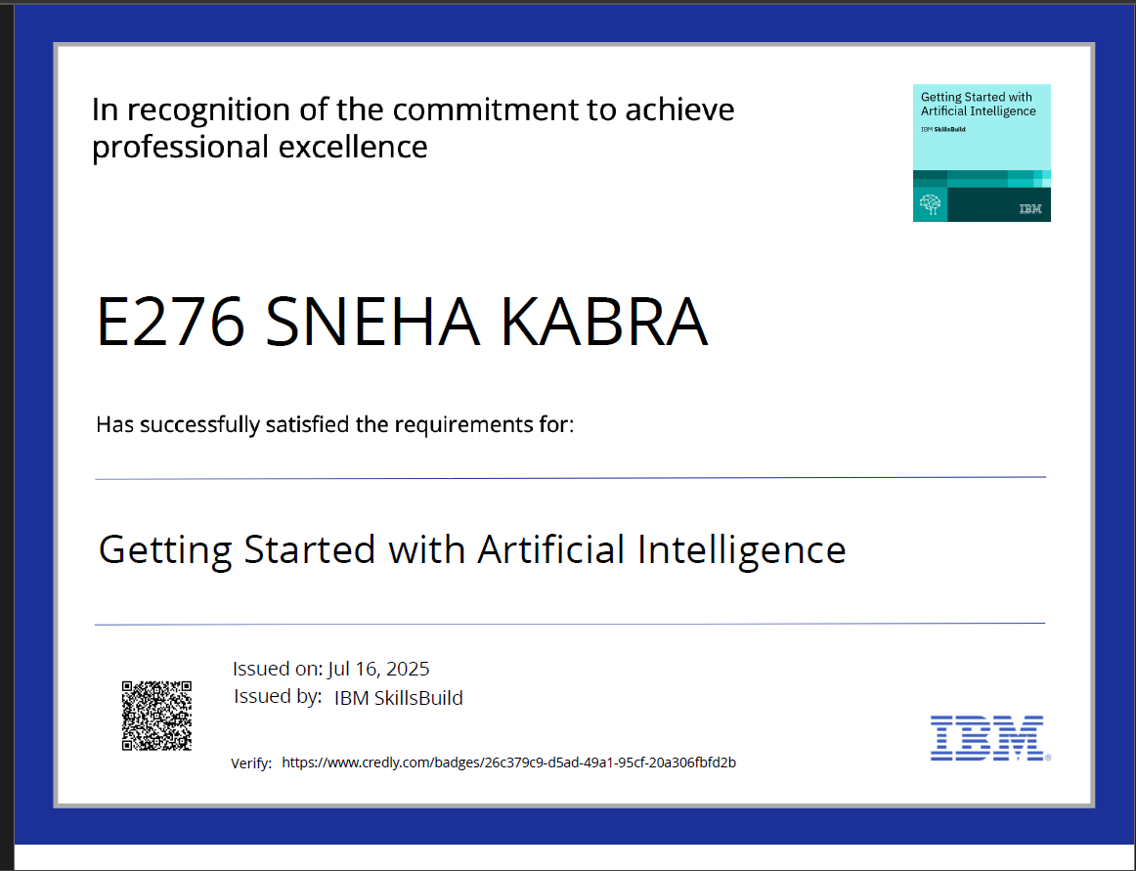
IBM Certifications
Screenshot/ credly certificate( getting started with AI)

Slide 15
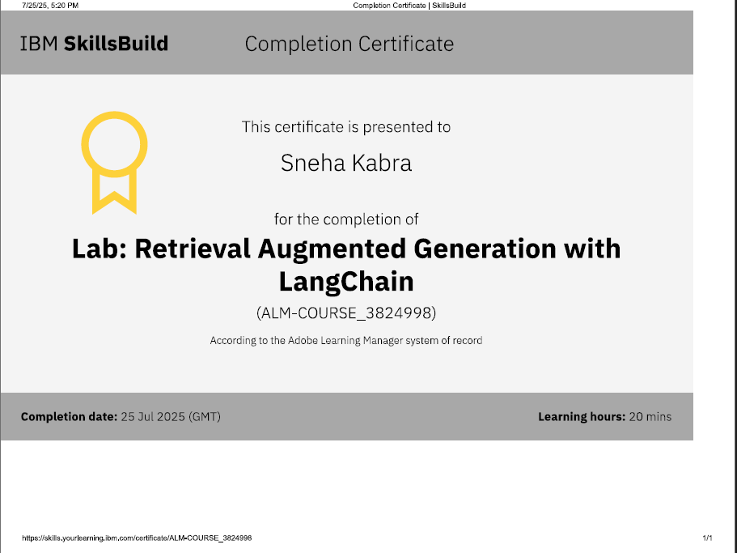
Attach your RAG LAB certificate here

Slide 16
Git hub lik : https://github.com/AswiniKumar55/Nutrion_agent

Slide 17
GitHub Link
Make sure that there should be readme file

Slide 18
THANK YOU

